Slide 1


Han (Hannah) Bao, Jeremy Montoya
Tse (Chester) Hsiao, Wanpeng Xu
Sentiment Analysis
of ChatGPT
Han (Hannah) Bao, Jeremy Montoya
Tse (Chester) Hsiao, Wanpeng Xu

Slide 2
Question: Do you know AIQ?

Slide 3
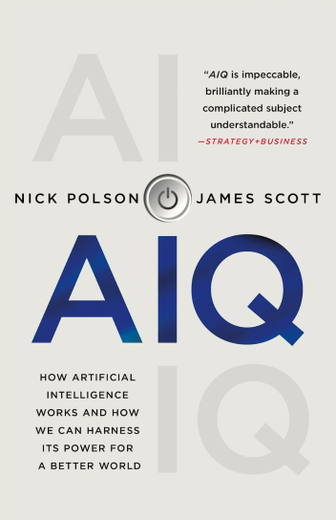
AIQ
The ability to use AI to make a better world/business/project/…

Slide 4

AIQ
The ability to use AI to make a better world/business/project/…
Sentiment Analysis
Notes:
get benefit or hurt

Slide 5
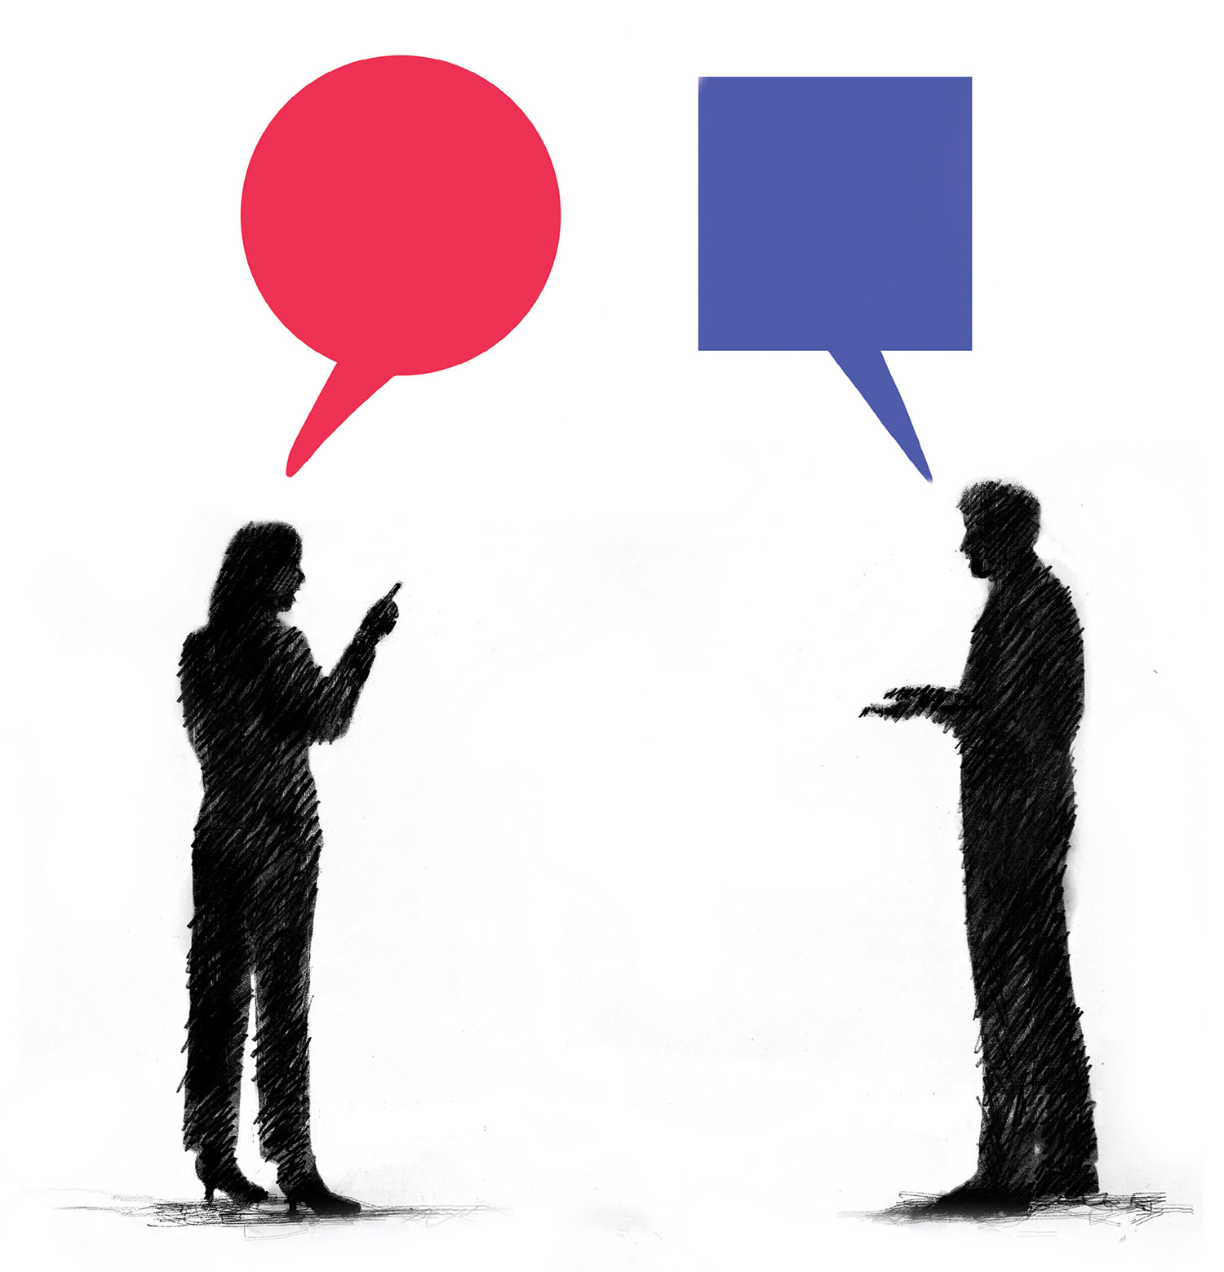
Business Goal: Improve AIQ
Individuals
Be guilty vs Be proud
Accept vs Refuse
Organizations
Ban vs Encourage
Lead vs Follow

Slide 6



Dataset
Description
20K Unlabeled tweets
(Apr. 2023)
200K Labeled tweets
(Nov. - Dec. 2022)
2K News Articles
(Nov.2022 - Apr. 2023)

Slide 7










System Design
Text Cleaning
Text Preprocessing
Feature Generation
Remove URL
Tokenization
Bag of Words
Labeled Tweets
Text Removal
TF-IDF
Convert Emojis
Stemming
Spelling Check
Scaled - Word Vector
Lemmatization
Model Evaluation
Model Training
Accuracy
Nayes Bayes
Analysis & Visualization
Precision
Crawled Data (unlabeled)
Decision Tree
Recall
Random Forest
F1 Score

Slide 8
Model Evaluation
 | Bag of Words | TFIDF | Scaled_WV
Naive Bayes | Accuracy: 0.8 Precision: 0.74 Recall: 0.92 F1 Score: 0.82 | Accuracy: 0.74 Precision: 0.67 Recall: 0.96 F1 Score: 0.79 | Accuracy: 0.61 Precision: 0.6 Recall: 0.7 F1 Score: 0.65
Decision Tree | Accuracy: 0.87 Precision: 0.86 Recall: 0.87 F1 Score: 0.87 | Accuracy: 0.85 Precision: 0.85 Recall: 0.86 F1 Score: 0.86 | Accuracy: 0.55 Precision: 0.57 Recall: 0.49 F1 Score: 0.53
Random Forest | Accuracy: 0.86 Precision: 0.84 Recall: 0.89 F1 Score: 0.87 | Accuracy: 0.84 Precision: 0.83 Recall: 0.86 F1 Score: 0.85 | Accuracy: 0.69 Precision: 0.78 Recall: 0.55 F1 Score: 0.65

Slide 9
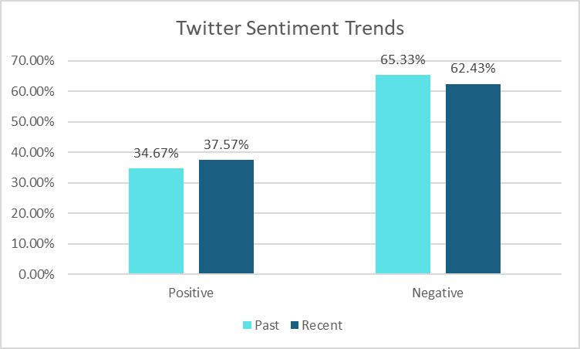
Recent Twitter are more positive than past
Notes:
in the past, high frequency of words in the positive category & high frequency for negative words

Slide 10
Top words of Tweets
Positive
(('ai', 'NN'), 9849),
(('face', 'NN'), 7269),
(('time', 'NN'), 5709),
(('question', 'NN'), 5693),
(('use', 'NN'), 5327),
(('thing', 'NN'), 5067),
(('code', 'NN'), 4730),
(('people', 'NNS'), 4663),
(('way', 'NN'), 4592),
(('google', 'NN'), 4422),
(('work', 'NN'), 603),
(('face', 'NN'), 448),
(('tool', 'NN'), 434),
(('use', 'NN'), 411),
(('hour', 'NN'), 269),
(('person', 'NN'), 263),
(('bhai', 'NN'), 258),
(('others', 'NNS'), 247),
(('people', 'NNS'), 245),
(('cherry', 'NN'), 236),
Top words of negative and positive are very similar in the same timeframe
Recent tweets focus more on personal usage, while past ones focus more on the industry, which may mean ChatGPT have been used more in daily life.
Past
Recent
(('ai', 'NN'), 7384),
(('face', 'NN'), 7351),
(('google', 'NN'), 4991),
(('chatbot', 'NN'), 3694),
(('question', 'NN'), 3636),
(('code', 'NN'), 3468),
(('time', 'NN'), 3167),
(('search', 'NN'), 3164),
(('use', 'NN'), 3150),
(('thing', 'NN'), 3082),
(('work', 'NN'), 979),
(('face', 'NN'), 729),
(('tool', 'NN'), 725),
(('use', 'NN'), 672),
(('hour', 'NN'), 453),
(('person', 'NN'), 424),
(('people', 'NNS'), 415),
(('bhai', 'NN'), 409),
(('others', 'NNS'), 407),
(('pas', 'NN'), 390),
Negative
Notes:
in the past, high frequency of words in the positive category & high frequency for negative words

Slide 11
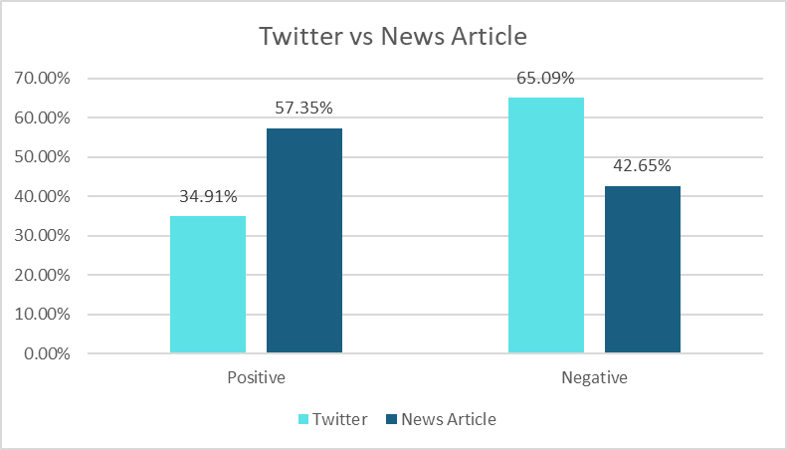
News Articles are more positive than Twitter
Notes:
in the past, high frequency of words in the positive category & high frequency for negative words

Slide 12
Top words of Positive & Negative News Article
Positive
company
year
technology
time
content
people
information
model
word
tool
Negative
company
year
technology
information
content
data
time
business
word
intelligence
Top words of negative and positive are very similar in the same timeframe
Notes:
in the past, high frequency of words in the positive category & high frequency for negative words

Slide 13

Conclusion
Recent tweets
More positive
(vs past tweets)
Recent Tweets focus more on personal usage
1
2
News Article
More Positive
(vs tweets)
3

Slide 14
Recommendation
1
2
Individuals
Be proud
Learn More
Organizations
New Strategy
“data/business/intelligence”

Slide 15
Future Direction
1
2
3
Advanced
Twitter API
Topic Model
longer Time

Slide 16
Thank You
Any Questions?

